Slide 1
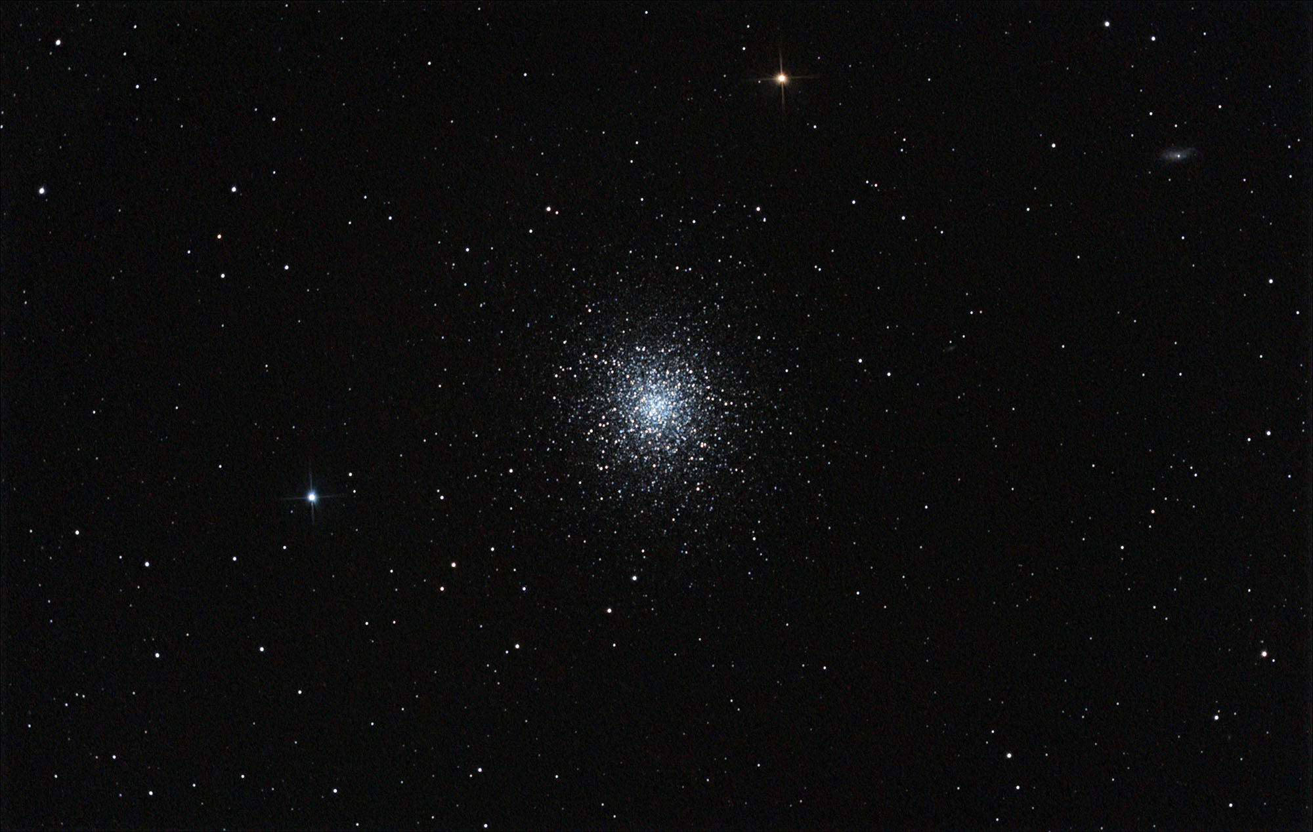
The HR Diagram & Globular Clusters

Slide 2
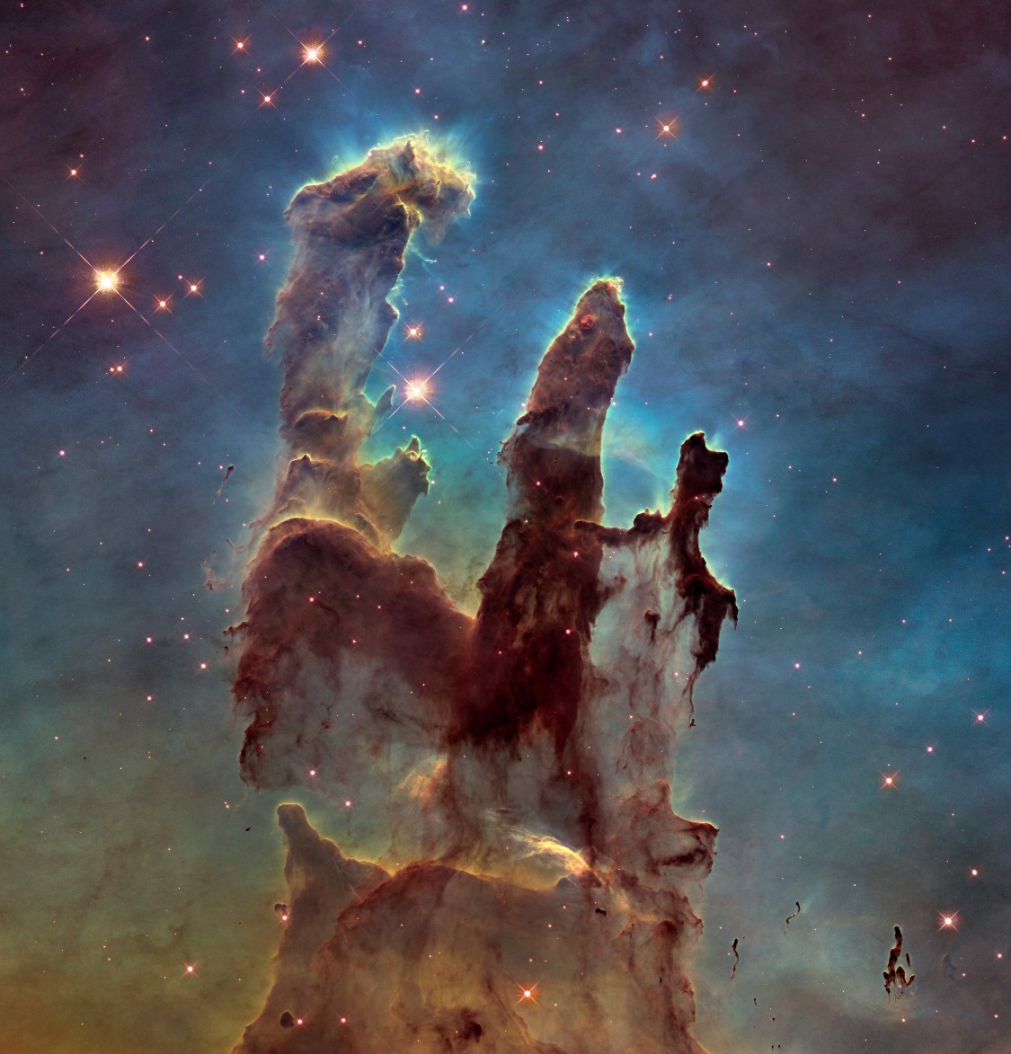
Which star is hottest?
a G5 main sequence star
a K2 supergiant
an F3 main sequence star
an F8 horizontal branch giant

Slide 3
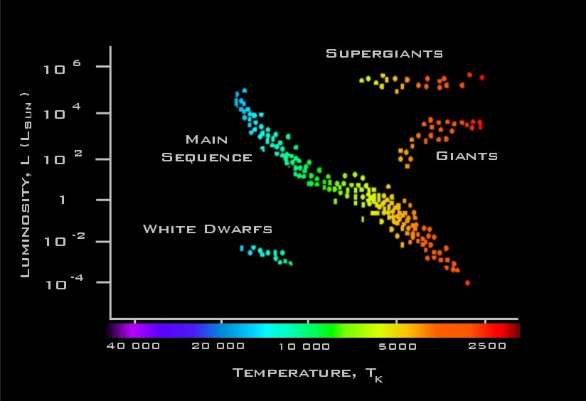
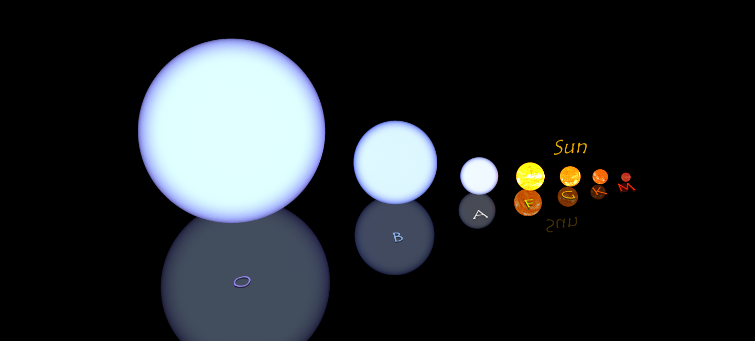
Which star is hottest?
a G5 main sequence star
a K2 supergiant
an F3 main sequence star
an F8 horizontal branch giant

Slide 4
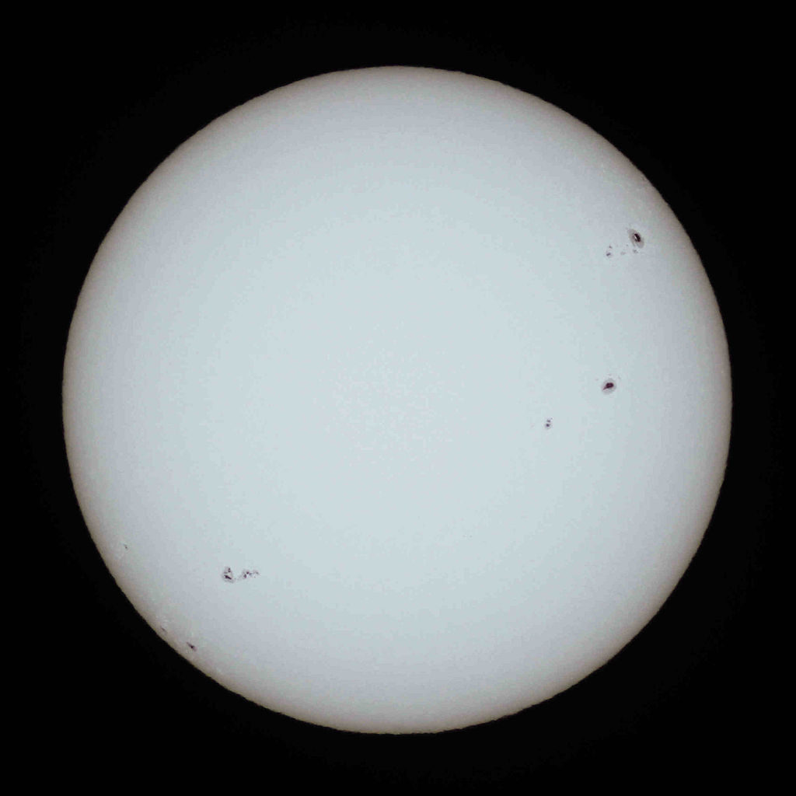
What’s the distance to the dimmer star with respect to the brighter star?
3 times closer
9 times closer
3 times further away
9 times further away
Our Sun is a G2V star

Slide 5
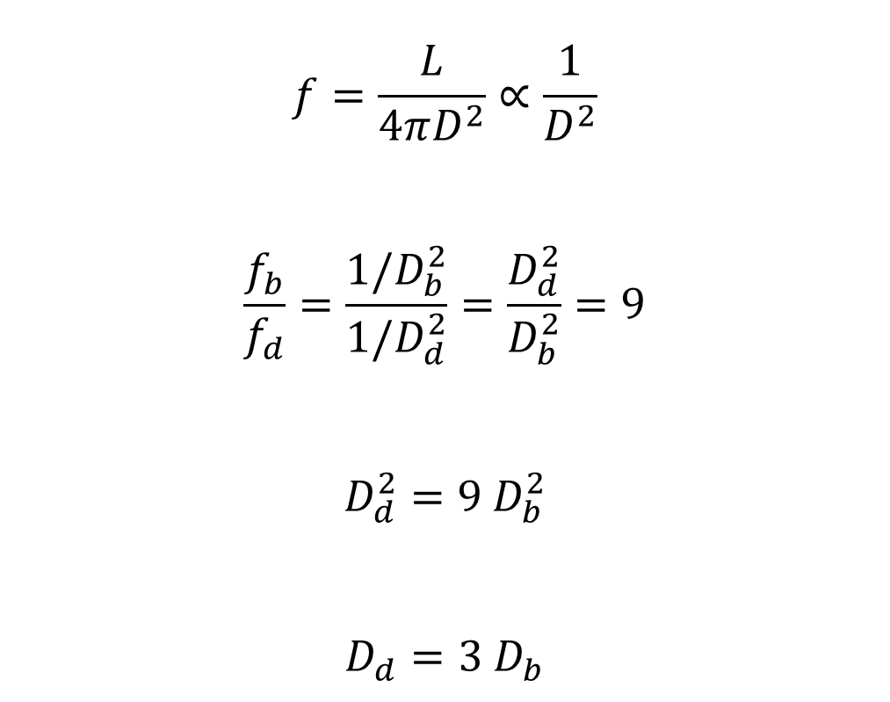
What’s the distance to the dimmer star with respect to the brighter star?
$$f=\frac{L}{4πD^{2}}∝\frac{1}{D^{2}}$$
$$\frac{f_{b}}{f_{d}}=\frac{1/D_{b}^{2}}{1/D_{d}^{2}}=\frac{D_{d}^{2}}{D_{b}^{2}}=9$$
$$D_{d}^{2}=9 D_{b}^{2}$$
$$D_{d}=3 D_{b}$$
3 times closer
9 times closer
3 times further away
9 times further away

Slide 6
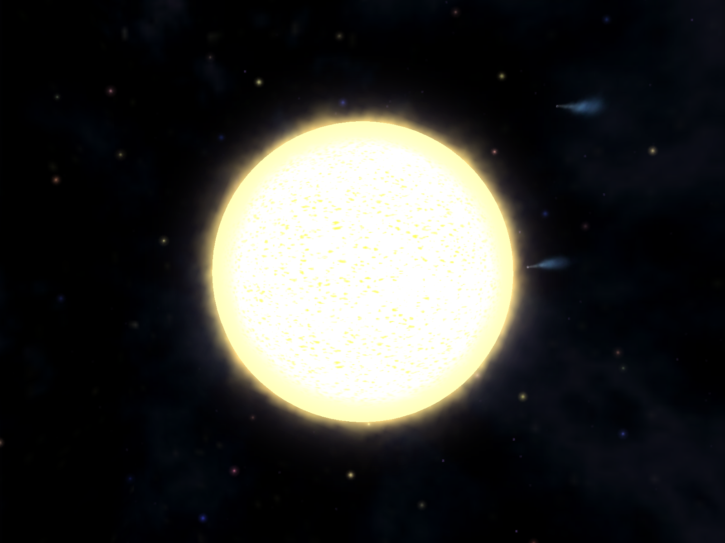
What does a color index of B-V = -0.11 mean for a star?
The star is more blue than red, so it is a hot star
The star is more blue than red, so it is a cool star
The star is more red than blue, so it is a hot star
The star is more red than blue, so it is a cool star

Slide 7
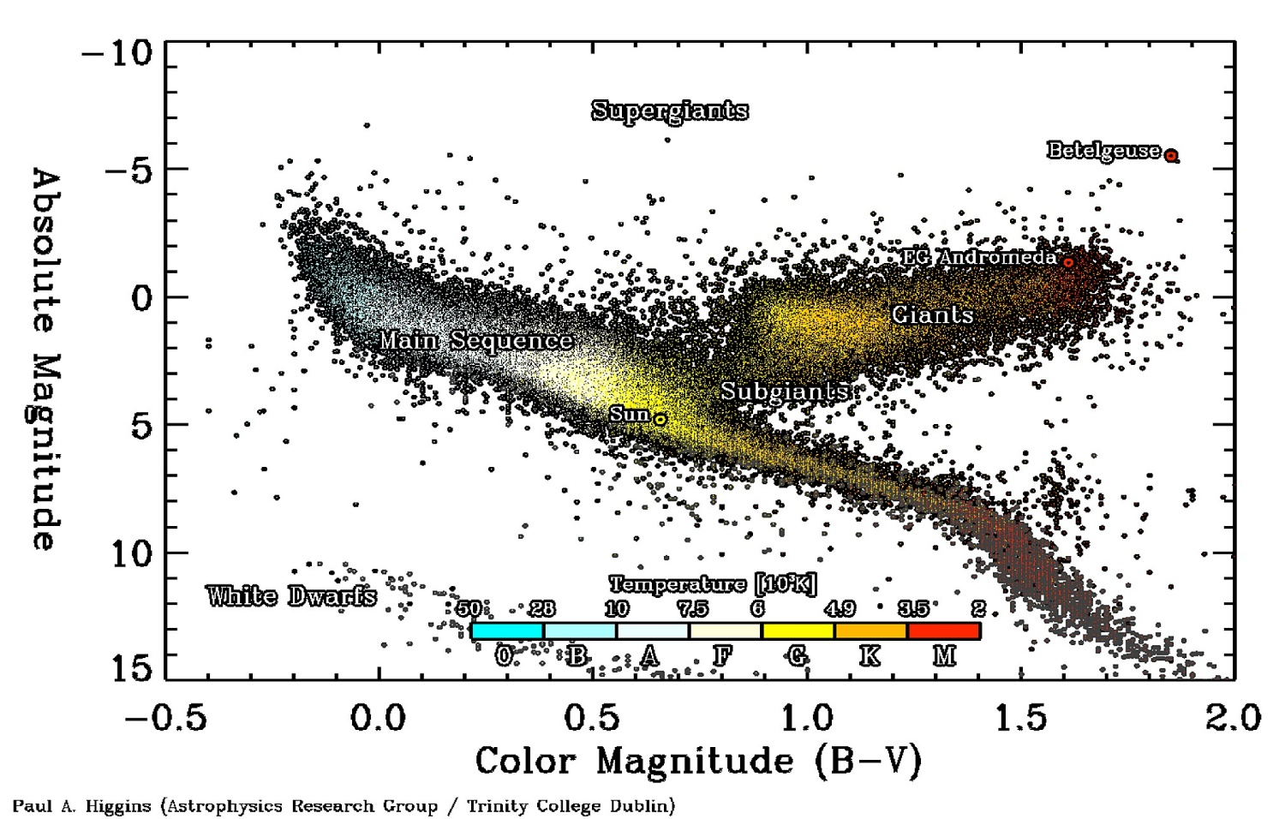
What does a color index of B-V = -0.11 mean for a star?
The star is more blue than red, so it is a hot star
The star is more blue than red, so it is a cool star
The star is more red than blue, so it is a hot star
The star is more red than blue, so it is a cool star

Slide 8
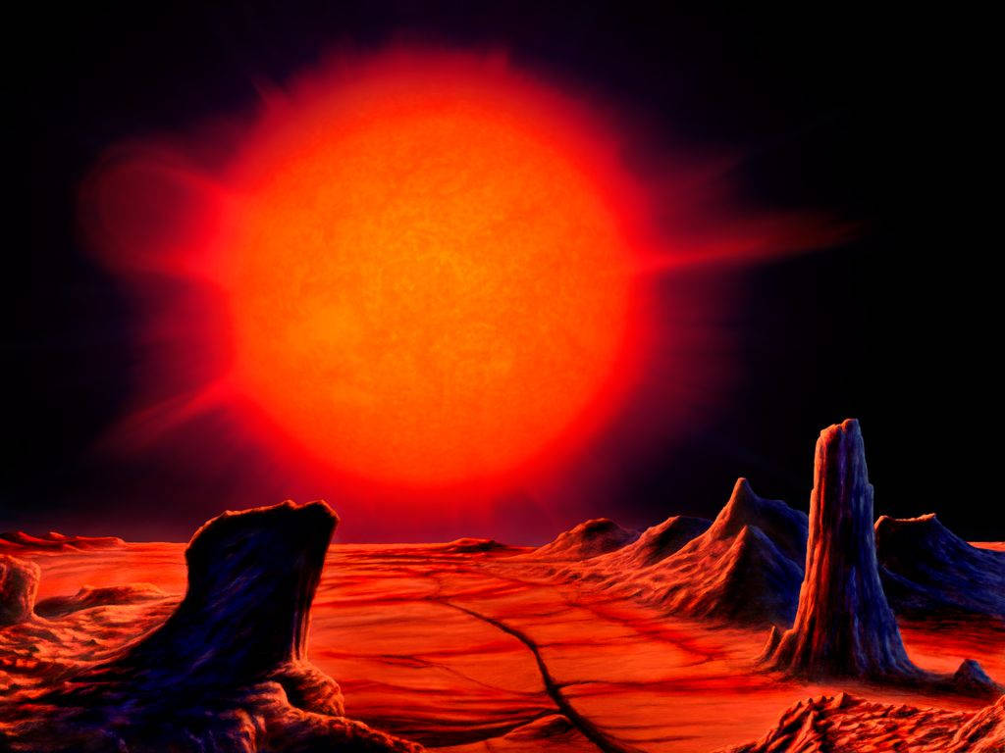
When a star becomes a red giant, it...
increases in temperature and luminosity
decreases in temperature and luminosity
increases in temperature and decreases in luminosity
decreases in temperature and increases in luminosity

Slide 9
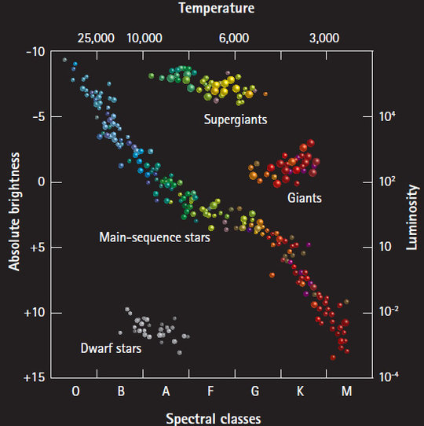
When a star becomes a red giant, it...
increases in temperature and luminosity
decreases in temperature and luminosity
increases in temperature and decreases in luminosity
decreases in temperature and increases in luminosity

Slide 10
Part 1

Slide 11
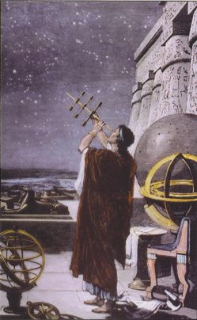
Stellar Magnitudes
Greek Astronomy
Hipparchus, 190 – 120 B.C.
Ptolemy, 100 – 170 A.D.
Rank stars based on brightness
Brightest = 1st Magnitude
Faintest = 6th Magnitude

Slide 12
Stellar Magnitudes
Advantages
Don’t need to worry about units
“Easier” to understand
Disadvantages
Integer numbers
Somewhat subjective
Telescopes + fainter objects
Filters + non-visible light

Slide 13
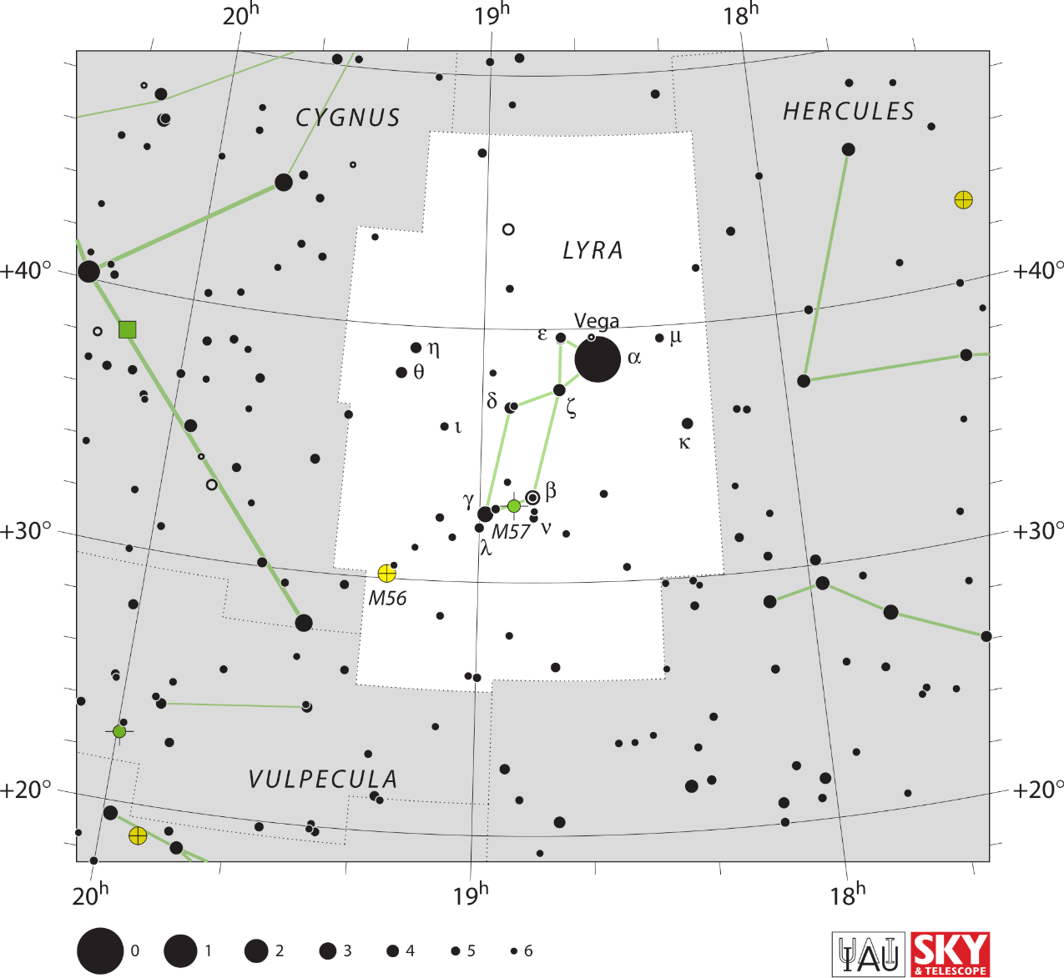
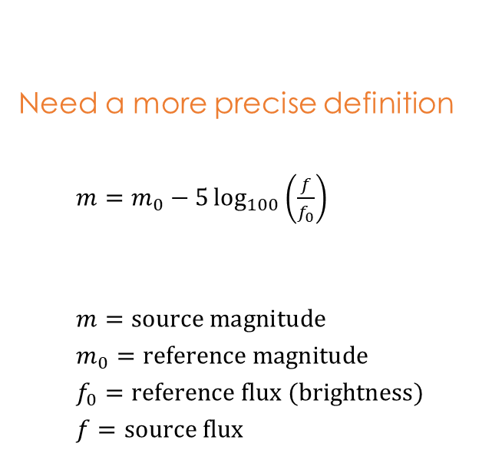
Apparent Magnitude
Need a more precise definition
$m=m_{0}−5\log_{100}\left(\frac{f}{f_{0}}\right)$
$m=source magnitude$
$m_{0}=reference magnitude$
$f_{0}=reference flux (brightness)$
$f=source flux$

Slide 14
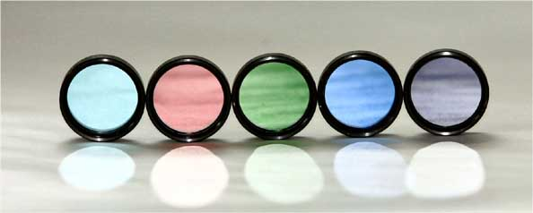
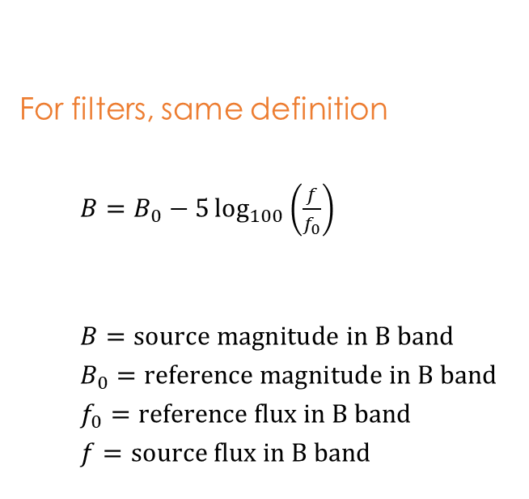
Apparent Magnitude
For filters, same definition
$B=B_{0}−5\log_{100}\left(\frac{f}{f_{0}}\right)$
$B=source magnitude in B band$
$B_{0}=reference magnitude in B band$
$f_{0}=reference flux in B band$
$f=source flux in B band$

Slide 15

Apparent Magnitude
For filters, same definition
$V=V_{0}−5\log_{100}\left(\frac{f}{f_{0}}\right)$
$V=source magnitude in V band$
$V_{0}=reference magnitude in V band$
$f_{0}=reference flux in V band$
$f=source flux in V band$

Slide 16
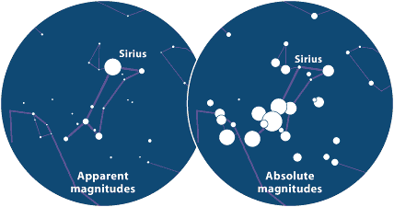
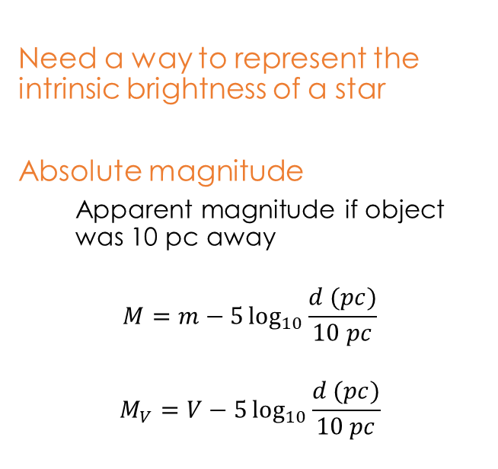
Absolute Magnitude
Need a way to represent the intrinsic brightness of a star
Absolute magnitude
Apparent magnitude if object was 10 pc away
$$M=m−5\log_{10}{\frac{d (pc)}{10 pc}}$$
$$M_{V}=V−5\log_{10}{\frac{d (pc)}{10 pc}}$$

Slide 17
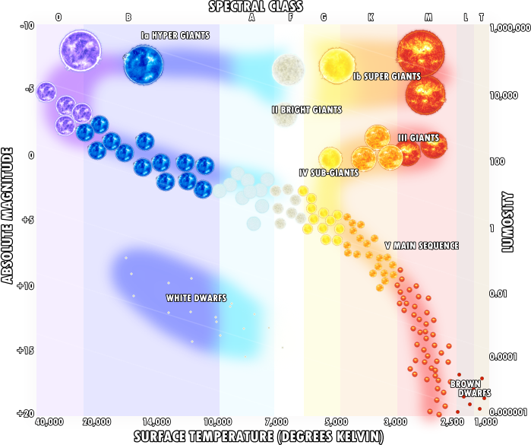
HR Diagram
Ejnar Hertzsprung & Henry Russell
1910 – Temperature vs Brightness
Main Sequence
Most common
Hydrogen fusion in core

Slide 18
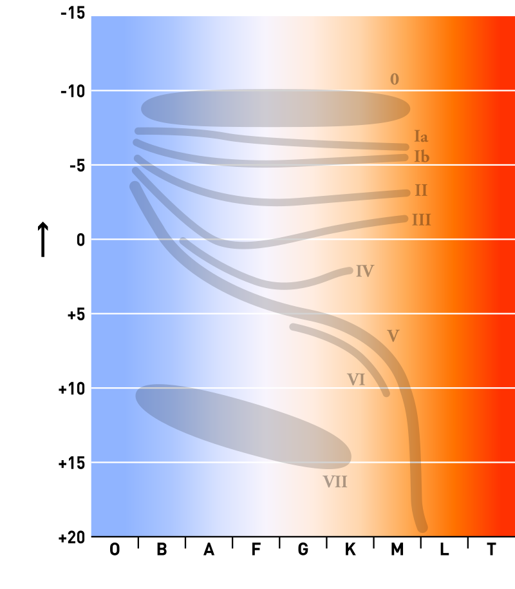
Luminosity Classes
0 Hypergiants
I Supergiants
II Bright Giants
III Giants
IV Sub-Giants
V Main Sequence
VI Subdwarfs
VII White Dwarfs

Slide 19
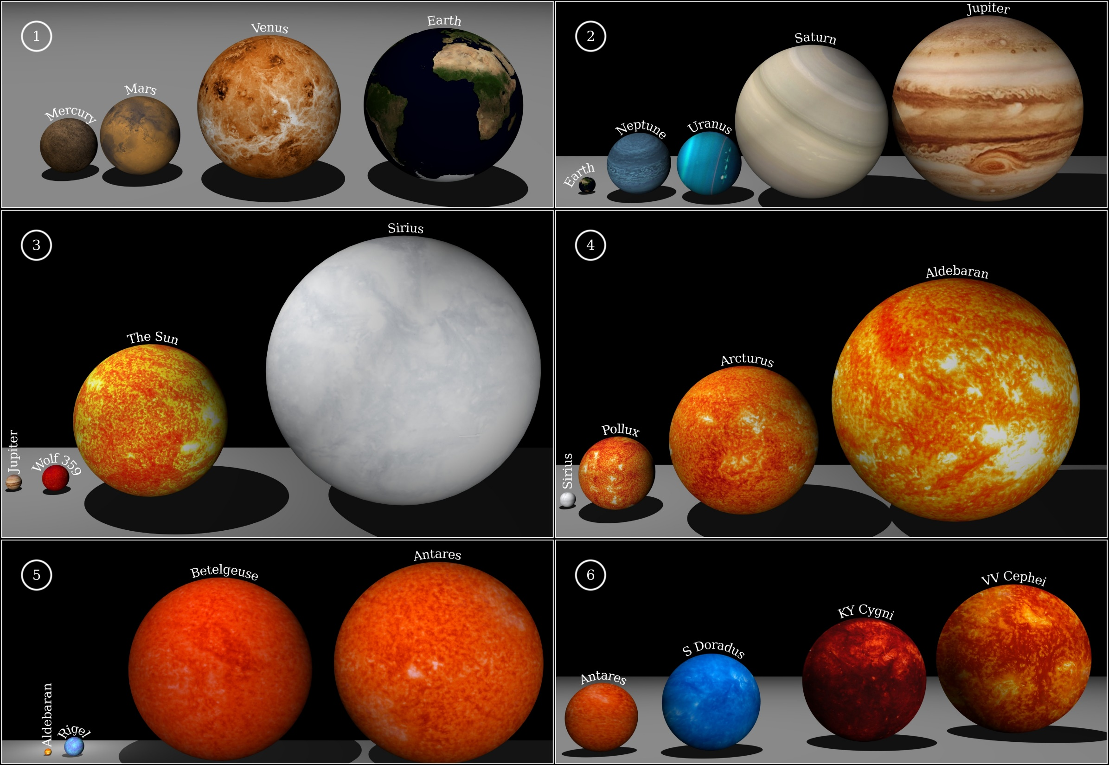

Slide 20
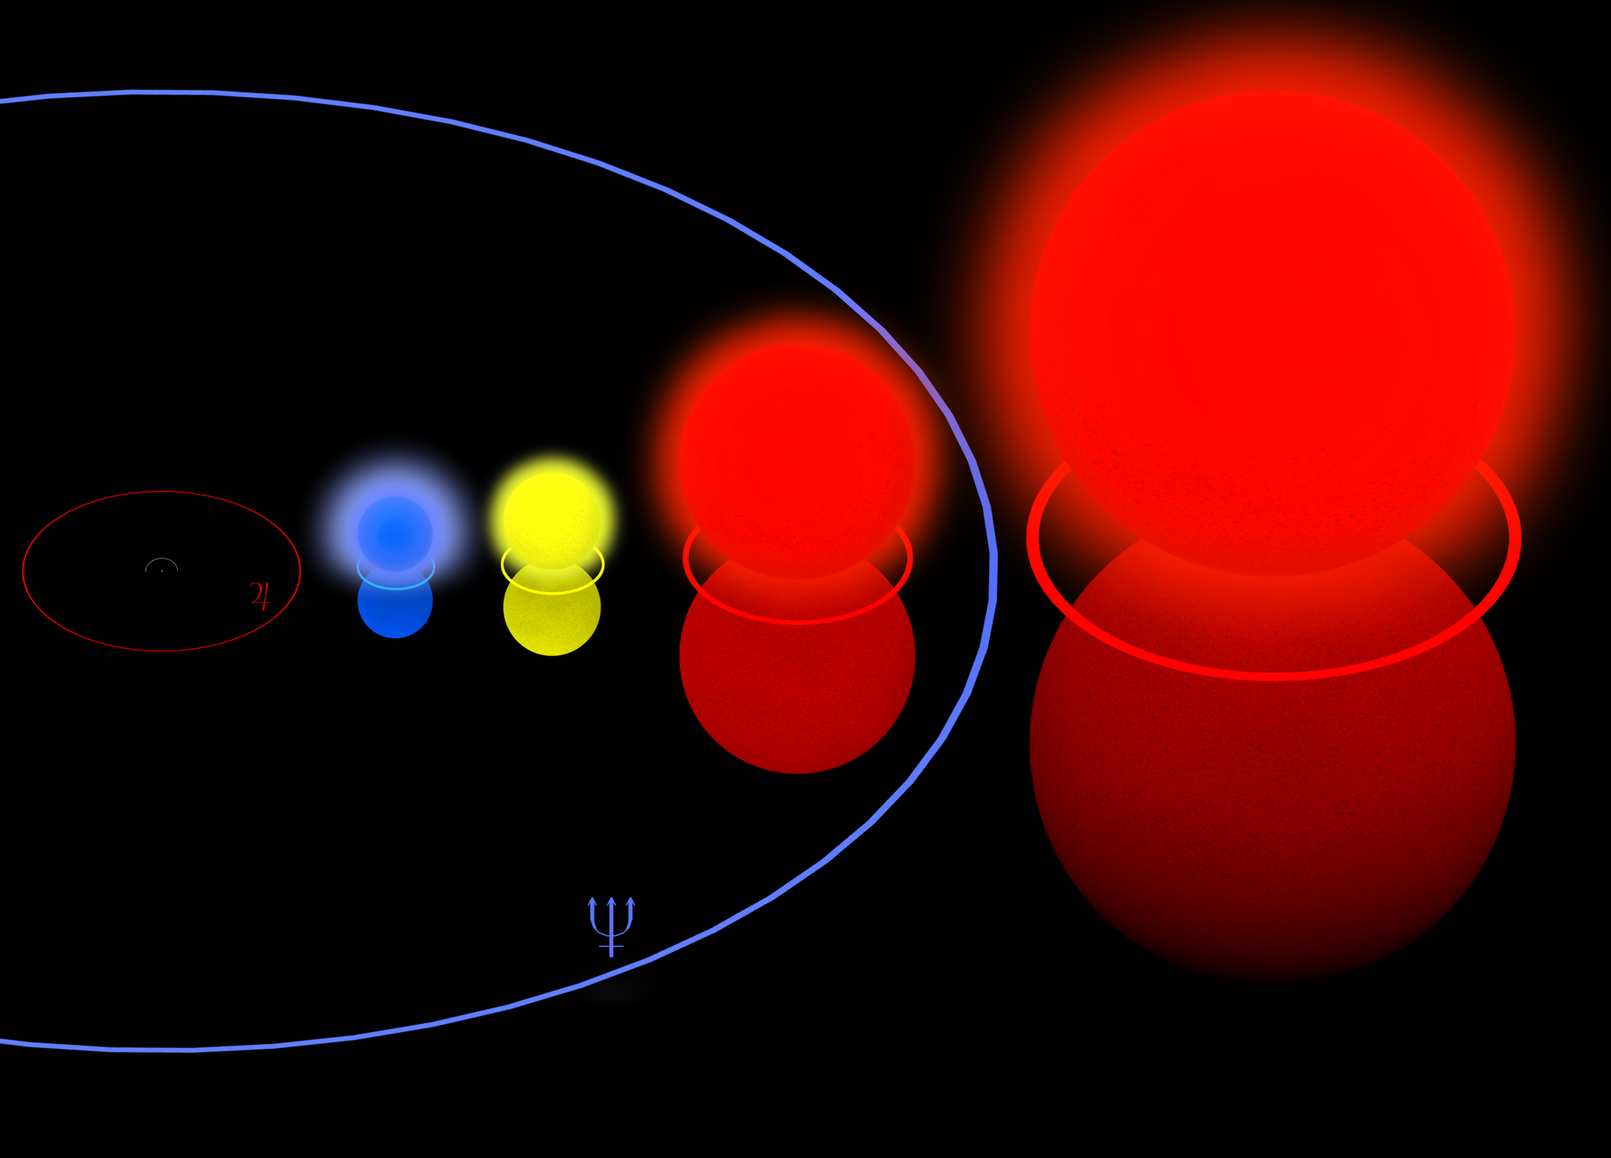
VY Canis Majoris
Pistol Star
Betelgeuse
Rho
Cassiopeiae

Slide 21
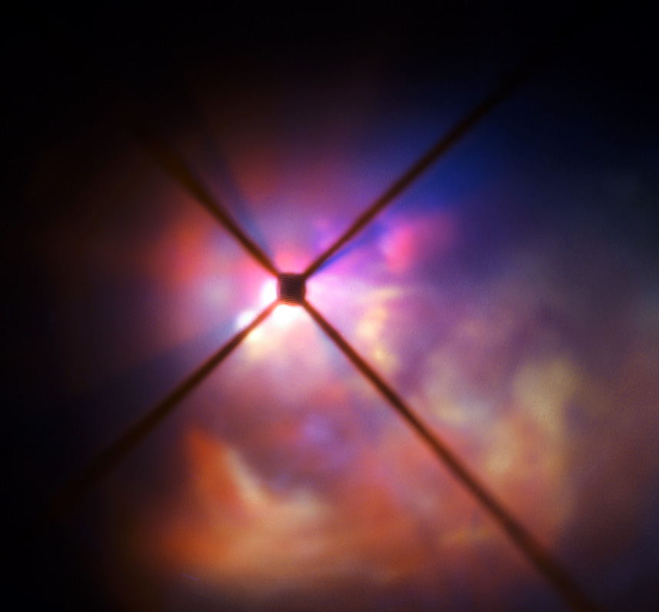
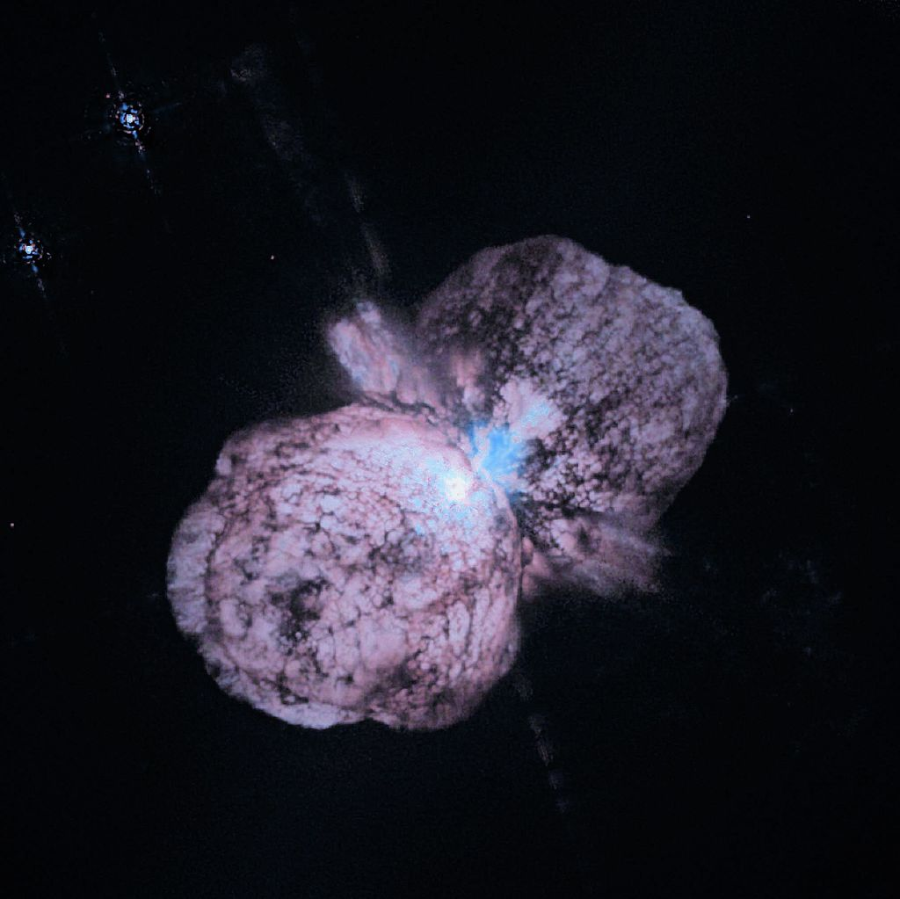
Stellar Outflows
VY Canis Majoris
Eta Carina

Slide 22
Spectral Types
Temperature classification
Mnemonics
O be a fine girl/guy kiss me
Over by Australia farmers give kangaroos money
O boy an F grade kills me
Only boring astronomers find gratitude knowing mnemonics

Slide 23
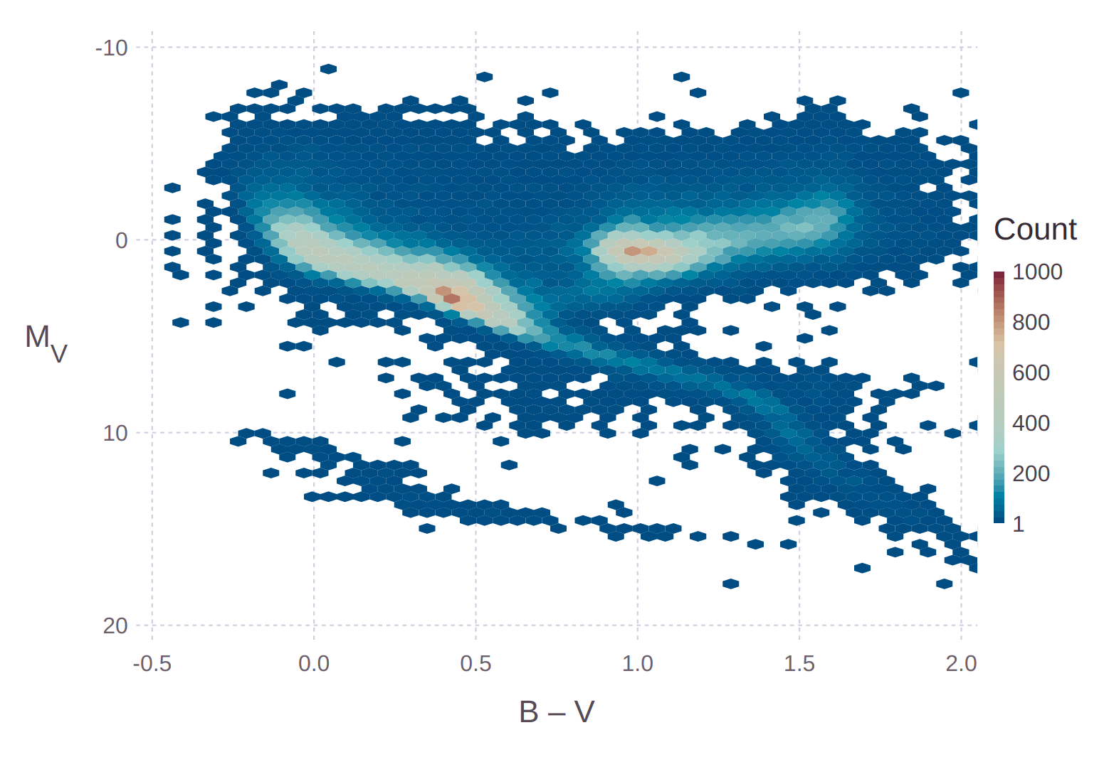

Slide 24
Part 2

Slide 25
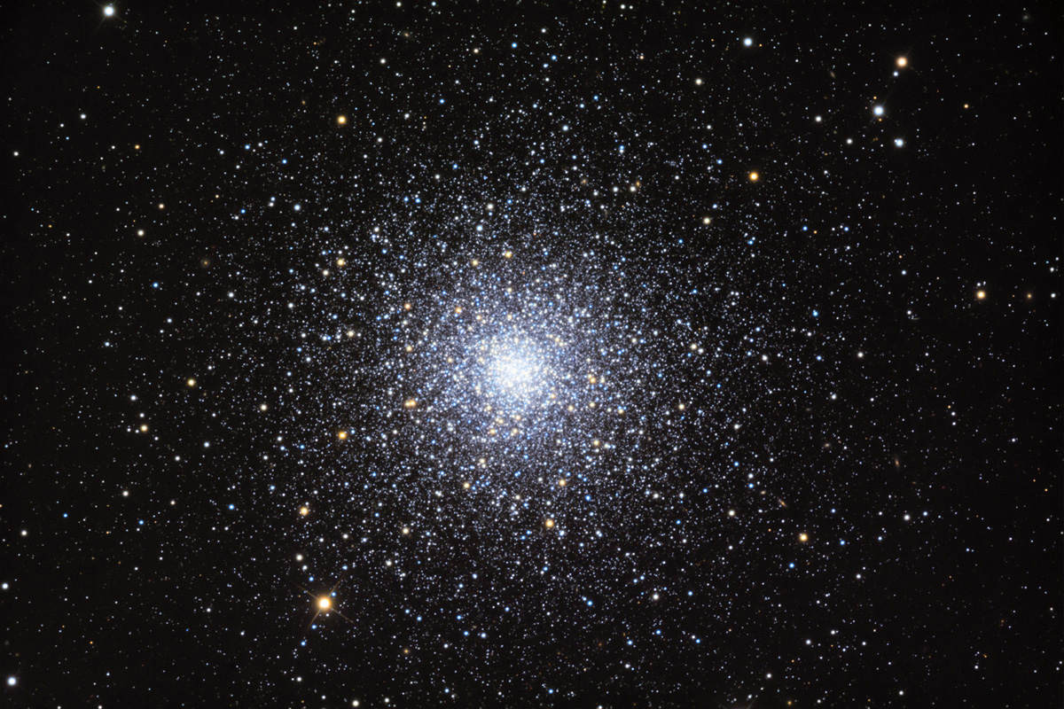
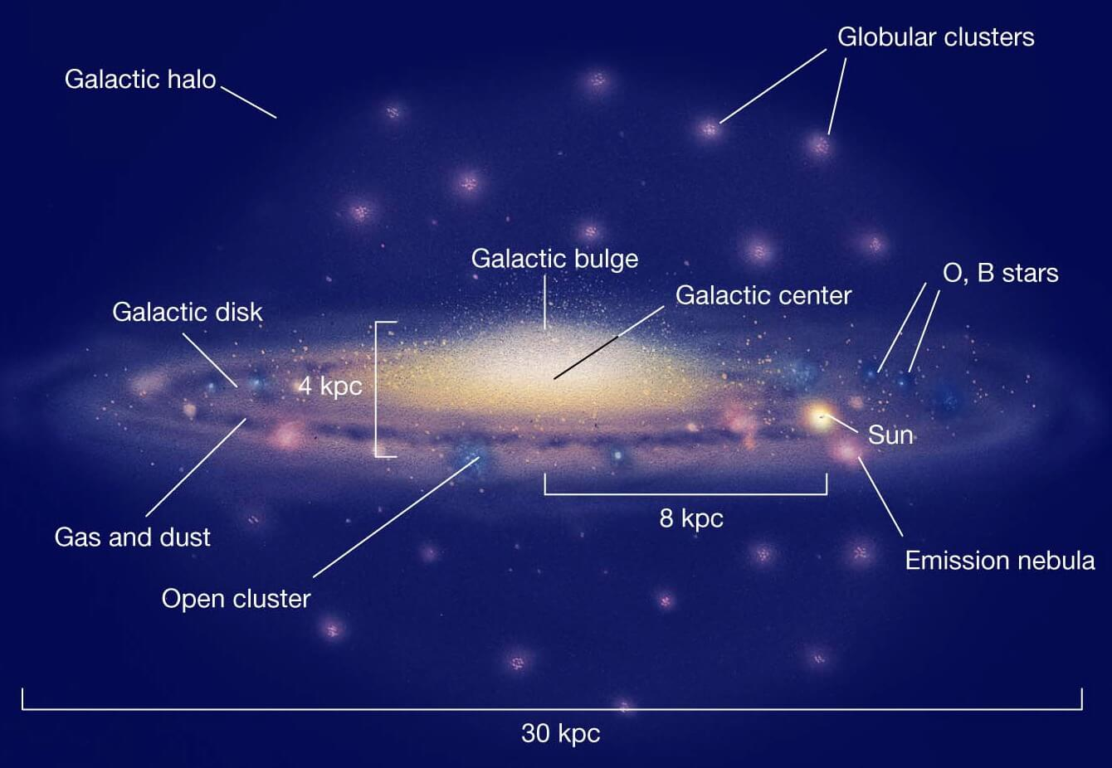
Globular Clusters
Very dense collection of stars gravitationally bound together
Found in galaxy halos
Milky Way ~ 150
Andromeda ~ 500
Stars of different sizes and masses
Stars are roughly the same age and the same distance away

Slide 26
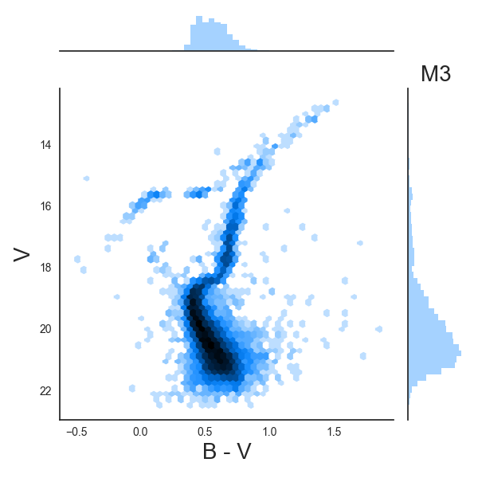
Globular Clusters
HR Diagram
Shape gives insight into stellar evolution
Main Sequence Turnoff Point
Determine the spectral type
Determine the age from main sequence lifetimes
https://youtu.be/wbvgjzW3Xz0?t=16s

Slide 27
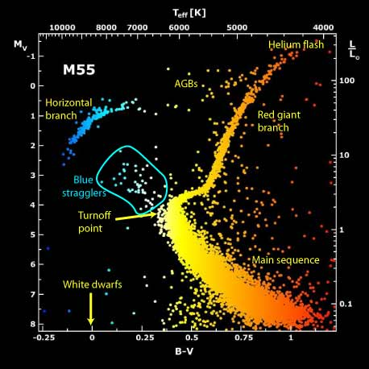
Stellar Evolution
Hydrogen fusion in core
Main Sequence
Core fusion ceases; continues in shell
Inert helium core (T too low)
Shells expand, increasing size
Red Giant Branch
Helium Flash
Core temperature increases
Helium fusion triggered
Pressure, luminosity drop
Horizontal Branch / Red Clump

Slide 28
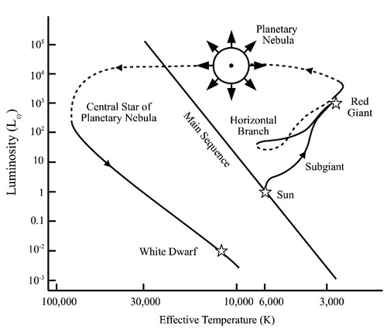
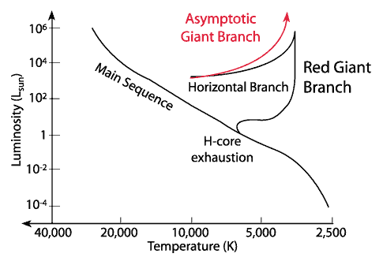
Stellar Evolution
Helium Core fusion complete
Fusion proceeds to shell
Asymptotic Giant Branch (AGB)
Stellar Mass Loss
Stellar Winds, ~10 km / s
Mass Loss ~50 – 70%
Decreased opacity
Temperature “increases”
Core Exposed
White Dwarf = core remnant
UV light → Planetary Nebula

Slide 29
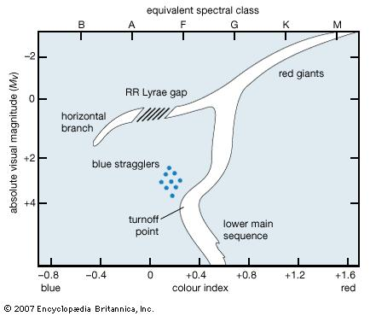
Additional Terms
Main Sequence Turnoff Point
Last spectral type on MS
Blue Stragglers
Main Sequence stars hotter than the Turnoff Point
Found near the center
Why are they there?
Mass transfer, stellar mergers
RR Lyrae Gap
Pulsating RR Lyrae Stars
Removed from Figures

